Slide 1
Real Time Sign Language Detection with TensorFlow Object Detection
Team:
D. Siddharth 1602-20-733-045
Rohith 1602-20-733-057

Slide 2
Abstract:
Language barriers are very much still a real thing. We can take steps to help close that speech to text and translators have made it a heap easier. We use TensorFlow Object Detection and Python to help close that gap. to take the first steps to doing just that! We built an end-to-end custom object detection model that allows you to translate sign language in real time. The sign language is a very important way of communication for deaf-dumb people. In sign language each gesture has a specific meaning. So therefore, complex meanings can be explained by the help of combination of various basic elements

Slide 3
Various sign language systems have been developed by many makers around the world but they are neither flexible nor cost-effective for the end users. Hence in this paper introduced software which presents a system prototype that is able to automatically recognize sign language to help deaf and dumb people to communicate more effectively with each other or normal people. In our method, the hand is first passed through a filter and after the filter is applied the hand is passed through a classifier which predicts the class of the hand gestures.

Slide 4
Libraries used:
OpenCV :Image Processing,Pattern Recognization
MediaPipe :Hand tracking and gesture recognition in real-time
Tensorflow :To create a real-time Sign Language Recognition system

Slide 5
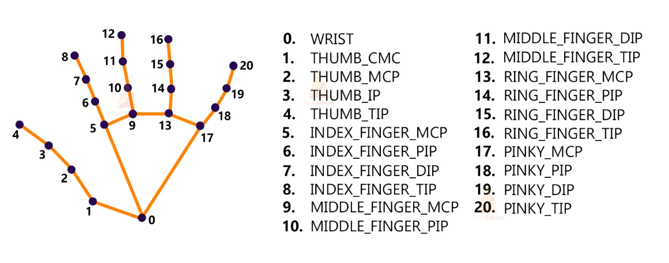
MediaPipe

Slide 6
Approach:
Import necessary packages.
Initialize models.
Read frames from a webcam.
Detect hand keypoints.
Recognize hand gestures.

Slide 7
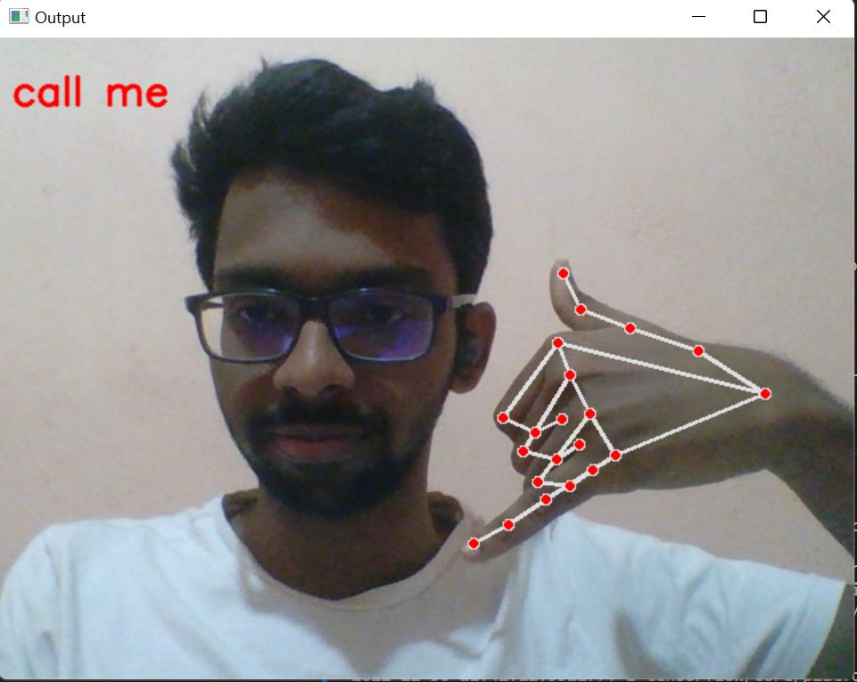
Results:

Slide 8
Thank You

